Slide 1


Big Mart Sales Analysis
-Kritika Sharma

Slide 2

Big Mart Sales Analysis
The data scientists at Big Mart have collected 2013 sales data for 1559 products across 10 stores in different cities. Also, certain attributes of each product and store have been defined. The aim is to build a predictive model and find out the sales of different products at a particular store.

Slide 3
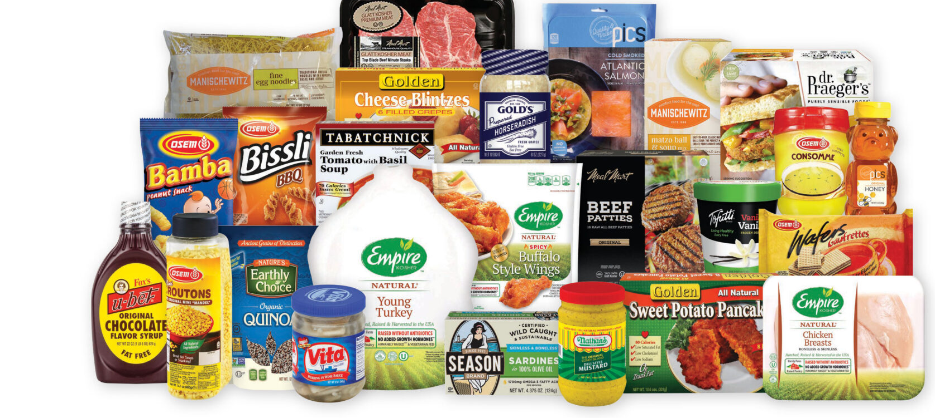
Goal of the project
Using this model, Big Mart will try to understand the properties of products and stores which play a key role in increasing sales.

Slide 4

Data collection
The website used for doing the prediction is : https://www.kaggle.com/datasets/bigmart-sales-data
The data set used here will be helpful for us to predict the item outlet sales based on the different parameters like- what is the item weight, what is the MRP of the item, what is the type of item, what is the outlet size etc. This is a general data set, that is observed and collected on various different parameters. All the parameters are continuous in nature.

Slide 5
https://www.kaggle.com/datasets/bigmart-sales-data
Item_Weight
Item_MRP
Outlet_Establishment_Year
Item_Outlet_Sales
Item_Type
Item_Visibility

Slide 6
Attributes Information
Item Weight- Weight of product
Fat Content in the Item- Whether the product is low fat or not
Item Visibility- The % of total display area of all products in a store allocated to the particular product
Item Type- The category to which the product belongs
Item MRP- Maximum Retail Price (list price) of the product
Outlet Establishment Year - The year in which the store was established

Slide 7
Attributes Information
7. Outlet Size- The size of the store in terms of ground area covered
8. Outlet Location Type- The type of city in which the store is located
9. Outlet Type- Whether the outlet is just a grocery store or some sort of supermarket
10. Item Outlet Sales- Sales of the product in the particular store. This is the outcome variable to be predicted

Slide 8
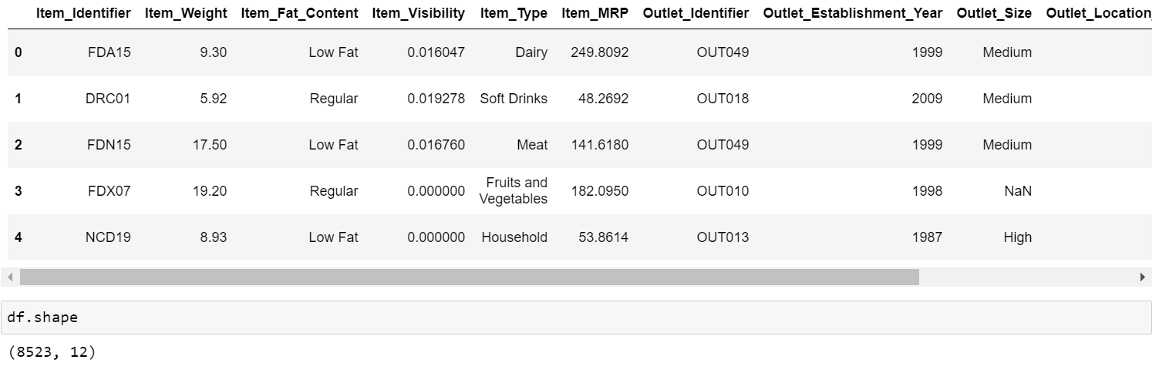
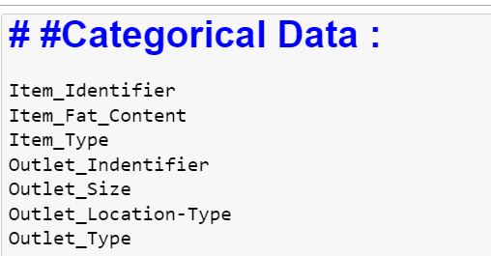
Understanding the DATA
There are 8523 rows and 12 columns

Slide 9
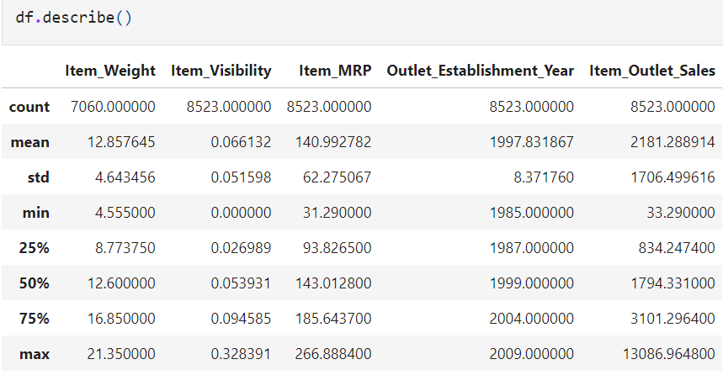
Describing the data Set

Slide 10
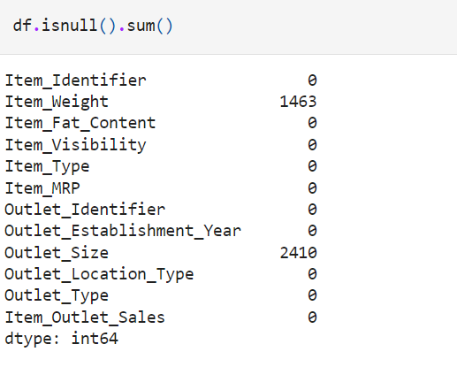
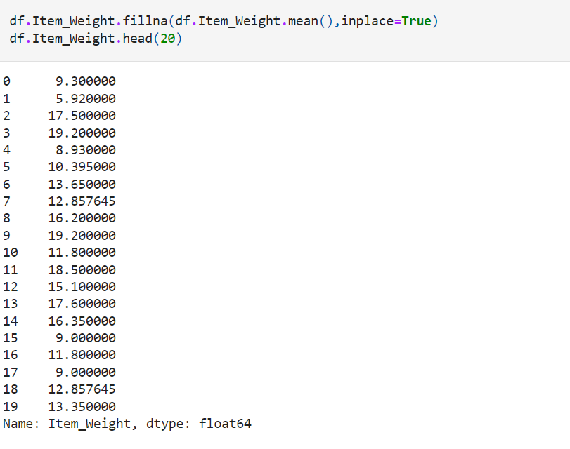
Cleaning the data set
Checking for null values in the dataset Handling the null values in Item_Weight

Slide 11
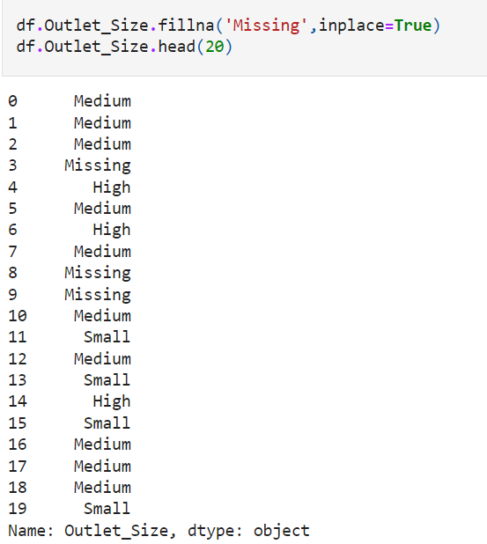
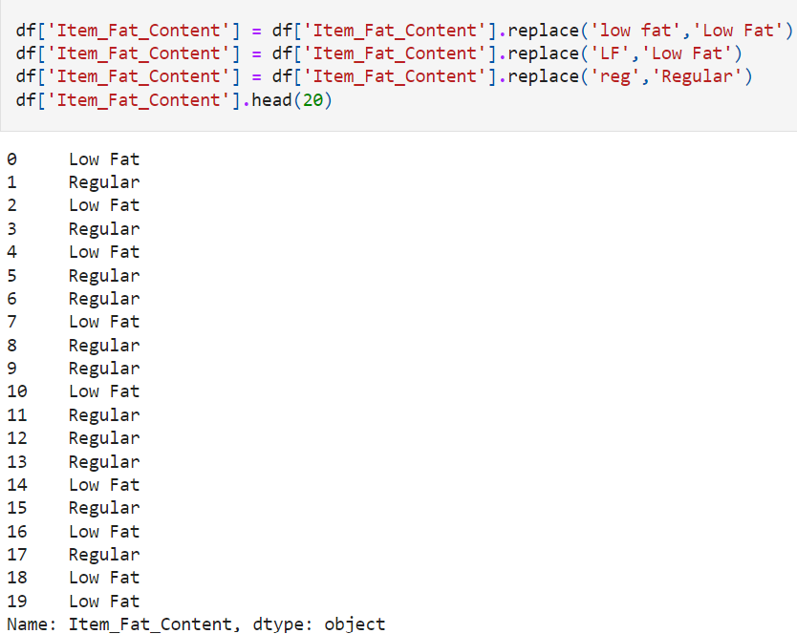
Cleaning the data set
Handling the null values in Outlet_Size Handling the mis-coded values in Item_Fat_Content

Slide 12
What Analysis we can do ?
1-Which outlet made most money
2 - is Outlet_Type affect on sales ?
3 - is Outlet_Location_Type affect on salaes ?
4 - Which is the most item_type sold ?
5 - in any year more supermarkets were established and why
6 - What is the most product sold

Slide 13
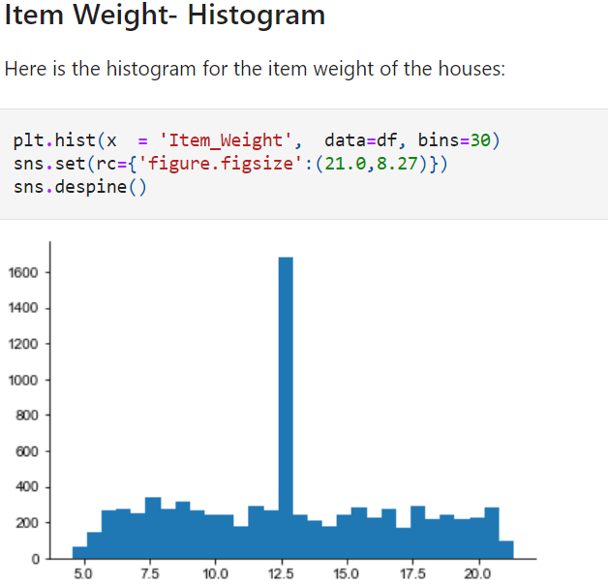
Analyzing the data
From the histogram, we can observe:
The above data is continuous in nature.
There are many outliers present in the
above graph.
3.The products with weight from 12-13 kg are
high in number.

Slide 14
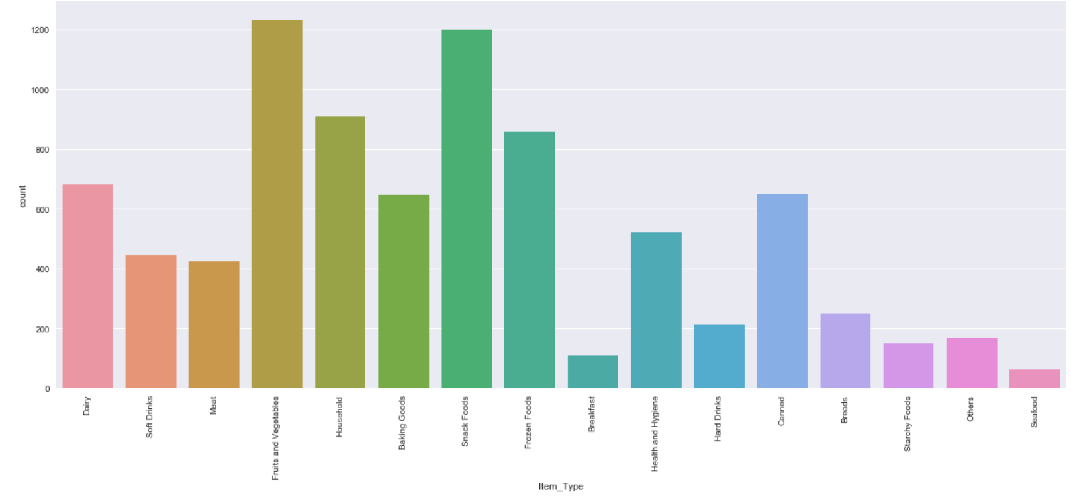
Analyzing the data
From the above count plot, we can observe:
The item type is distributed in 16 sections like dairy, soft drinks, meat etc.
The items related to fruits and vegetables and snack foods are high in number.
The items related to breakfast, seafood, starchy foods and others are less in number

Slide 15
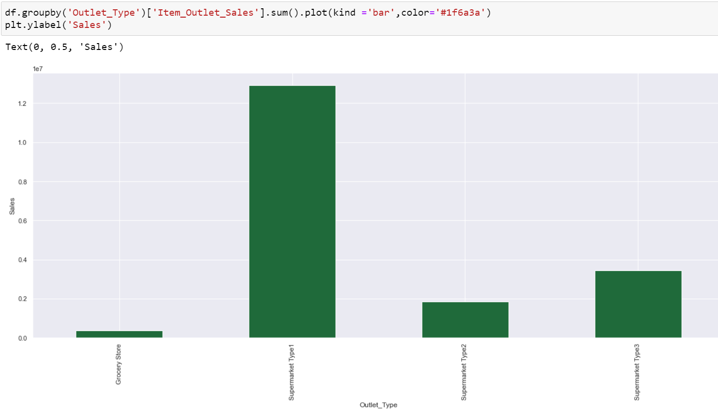
Analyzing the data

Slide 16
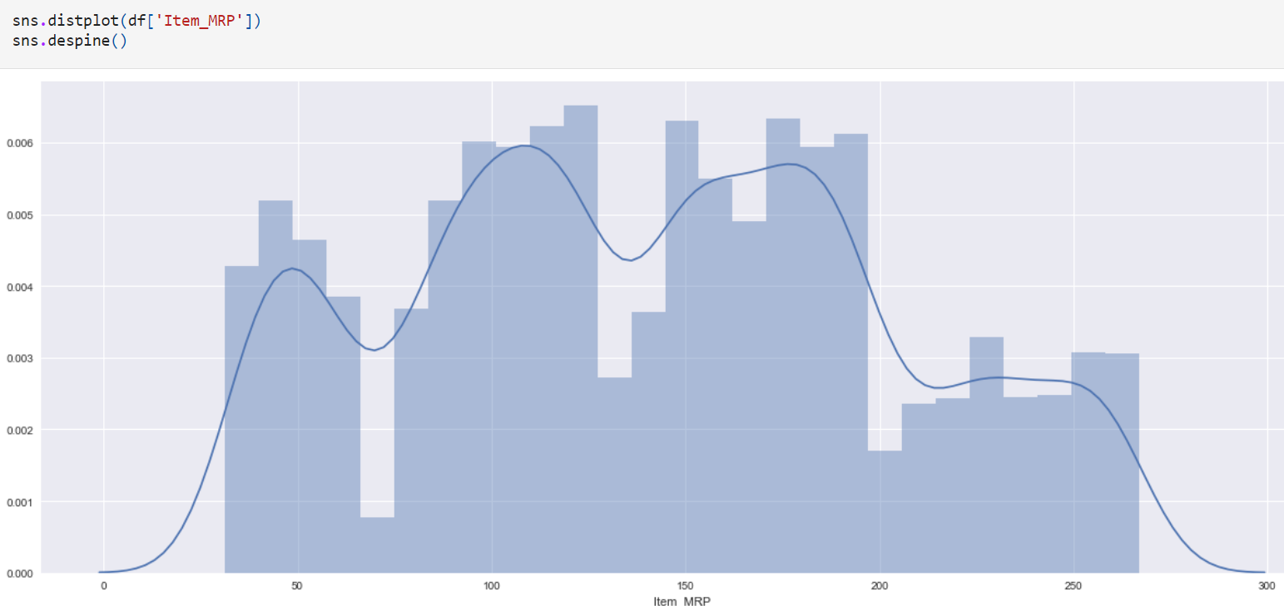
Analyzing the data Item MRP- Distribution plot
From the below plot, we can observe:
The products having price between 80-200 are high in number.
The products having price greater than 200 are less in number.

Slide 17
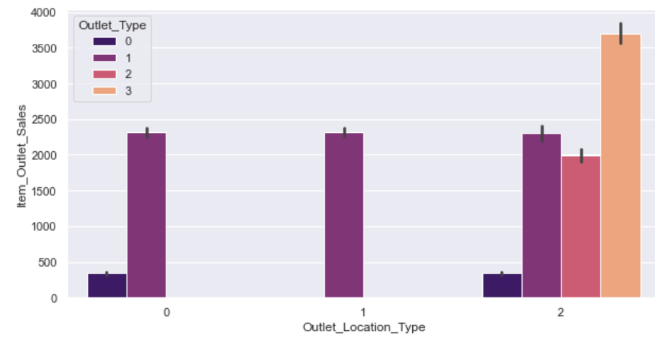
Analyzing the data Item MRP- Distribution plot
From the below plot, we can observe:
The Tier-3 location type has all types of Outlet type and has high sales margin.

Slide 18
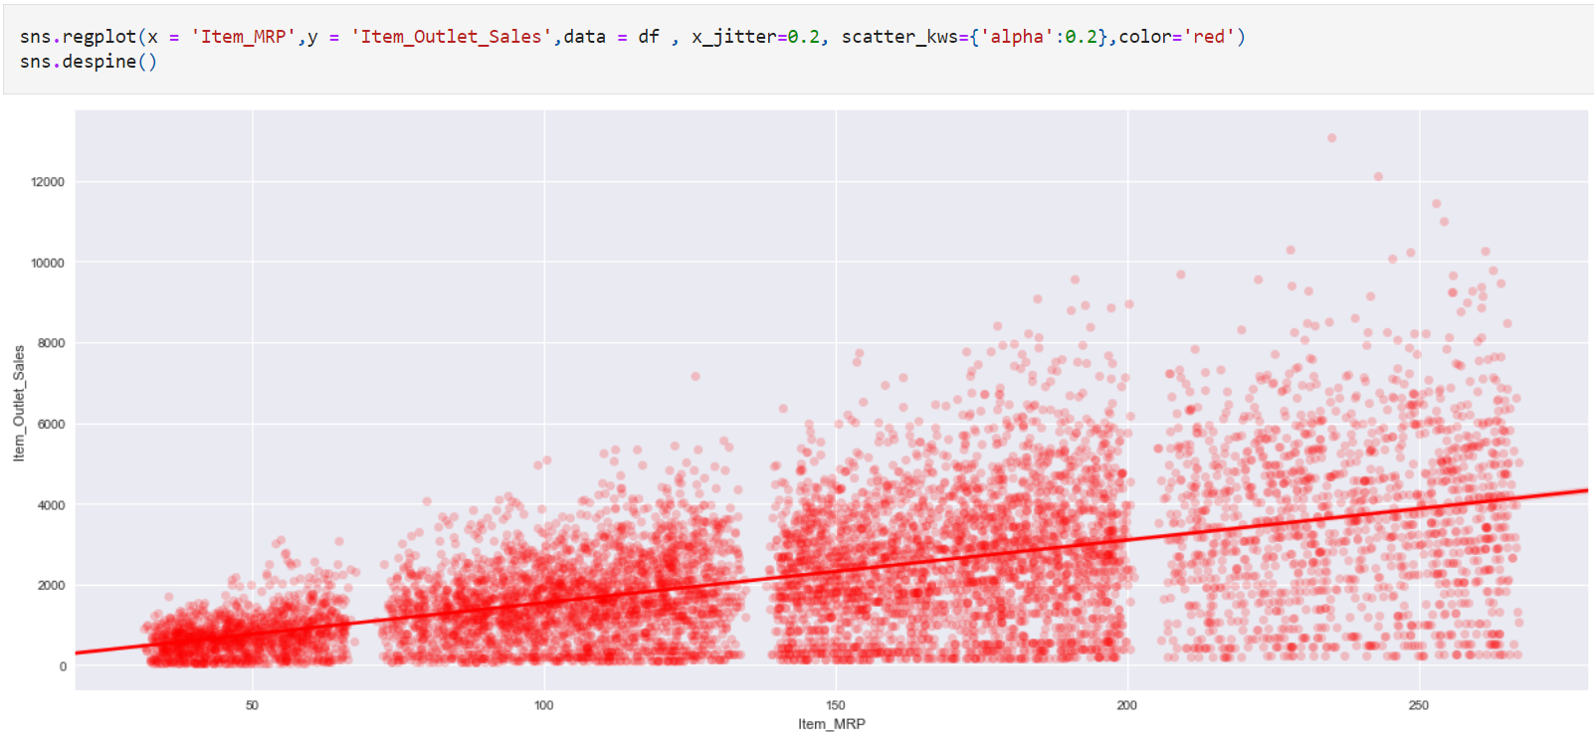
Analyzing the data
Item MRP vs Item Outlet Sales- Regression Plot
Notes:
From the above regression plot, we infer:
The outlets having less MRP products has less outlet sales.
The above distribution shows that as the item MRP increases the outlet sales also increases.
This shows that there exists a direct relation between the item MRP and the Outlet Sales.

Slide 19
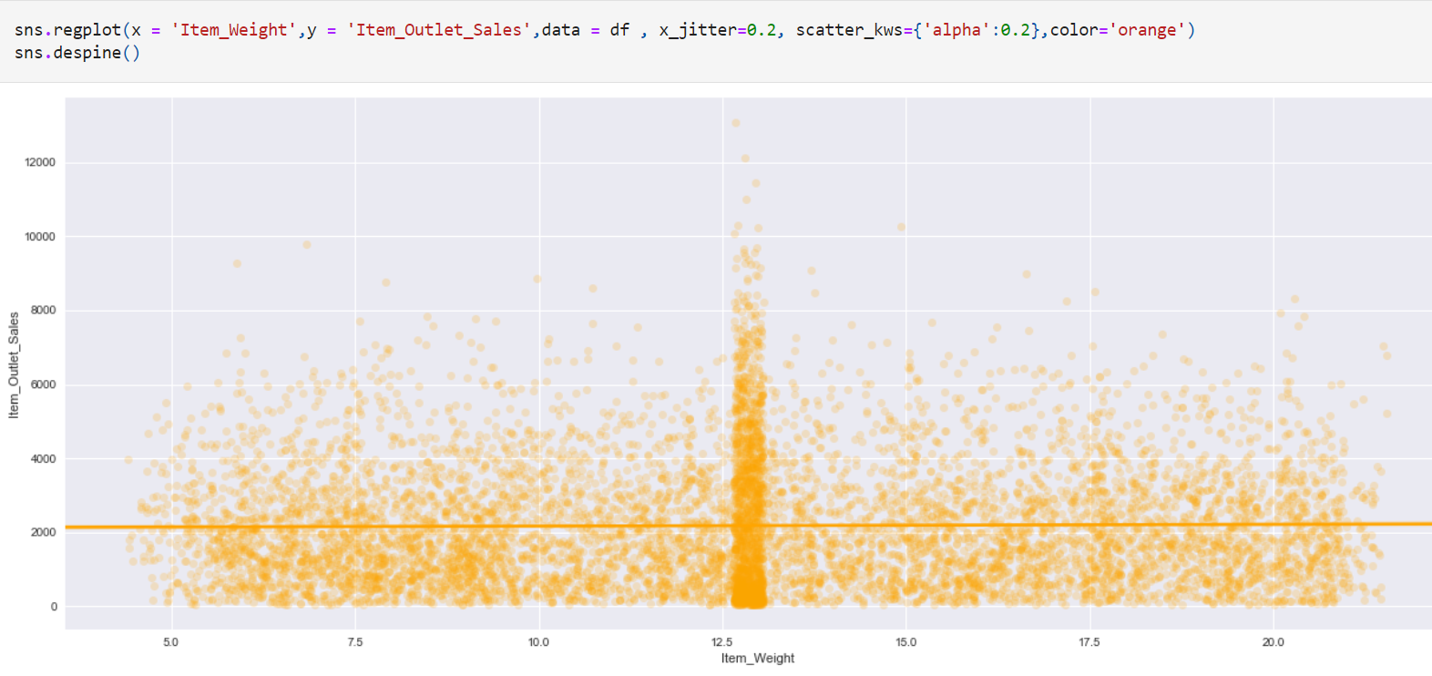
Analyzing the data
Item Weight vs Item Outlet Sales- Regression Plot
Notes:
From the above regression plot, we infer:
The products having weight between 12.5-13.5 kg have high outlet sales.
The above distribution shows that there is no relation between the outlet sales and weight as such.

Slide 20
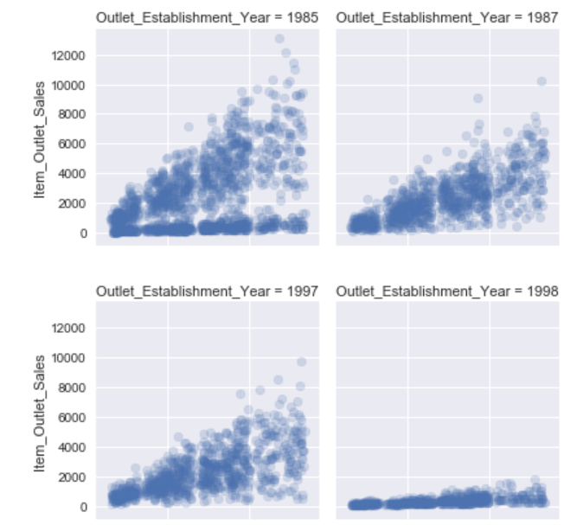
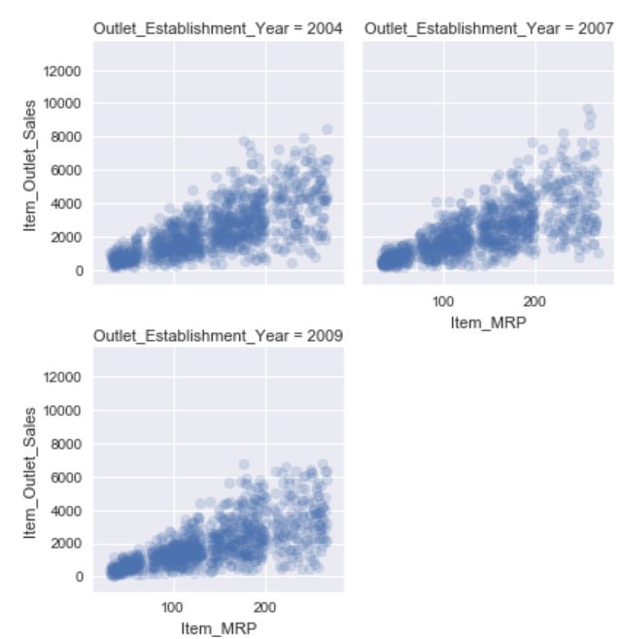
Analyzing the data
Item MRP vs Item Outlet Sales in terms of Outlet Establishment Year- Facet grid
Our main aim of this analysis is to predict the item outlet sales. Hence, we will analyze parameters with respect to item outlet sales here.
Notes:
From the above graphs, we infer:
High the MRP of the product, higher the outlet sales of the product.
Year 1998, have less outlet sales irrespective of the MRP of the product.

Slide 21
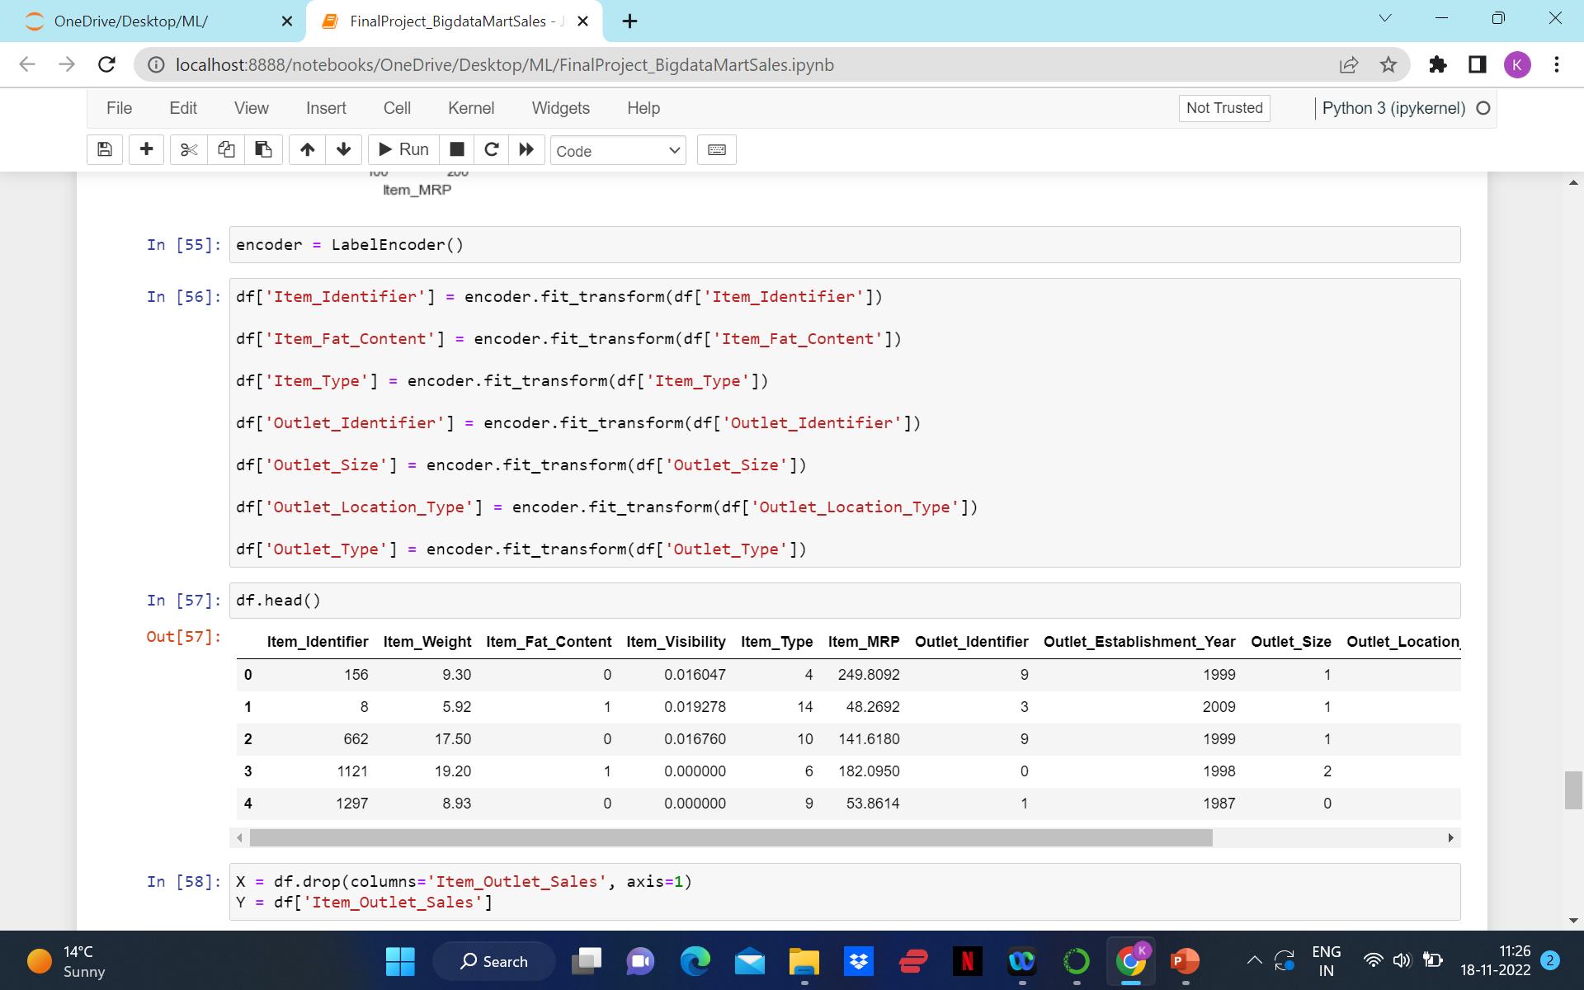
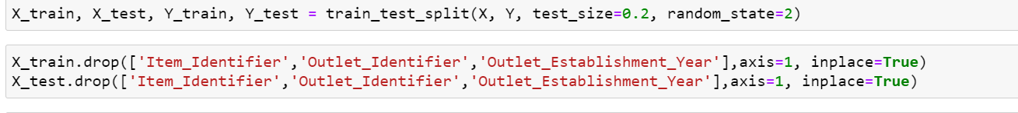
Defining the data and the target for building a regression model.

Slide 22
Defining the data and the target for building a regression model
Model | RMSE
Linear Regression | 1284.9106110780695
Polynomial Regression | 1284.9106110780695
Polynomial Regression 2nd Degree | 1138.5815821898984
Ridge Regression | 1344.421266691222
Lasso Regression | 1210.4571339315917

Slide 23


